Slide 1
Regression Fundamentals II
UIUC ECON 490: Applied Machine Learning in Economics

Slide 2


Hypothesis Testing
$$H_{0}:β_{i}=0$$
$$H_{a}:β_{i}≠0$$
Philosophy:
Never accept $H_{a}$
Can reject $H_{0}$ at $α$ confidence-level

Slide 3
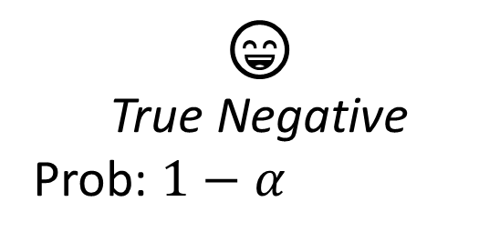
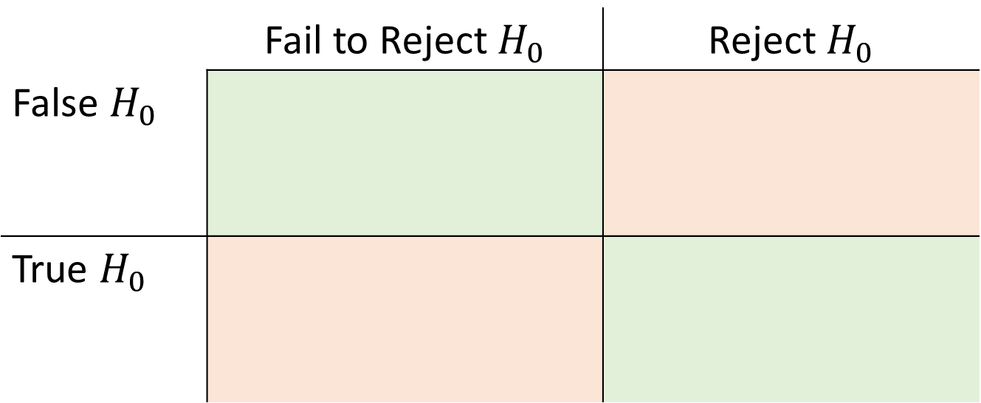
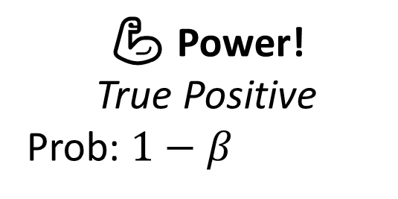
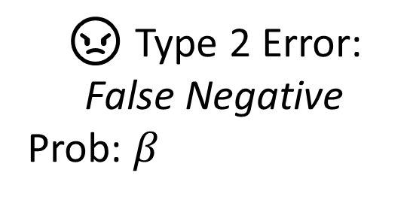
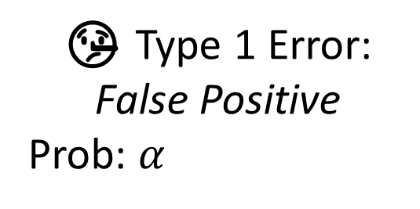
Types of Error
 | Fail to Reject $H_{0}$ | Reject $H_{0}$
False $H_{0}$
True $H_{0}$
😄
True Negative
Prob: $1−α$
🤥 Type 1 Error: False Positive
Prob: $α$
😠 Type 2 Error:
False Negative
Prob: $β_{ }$
💪 Power!
True Positive
Prob: $1−β$

Slide 4
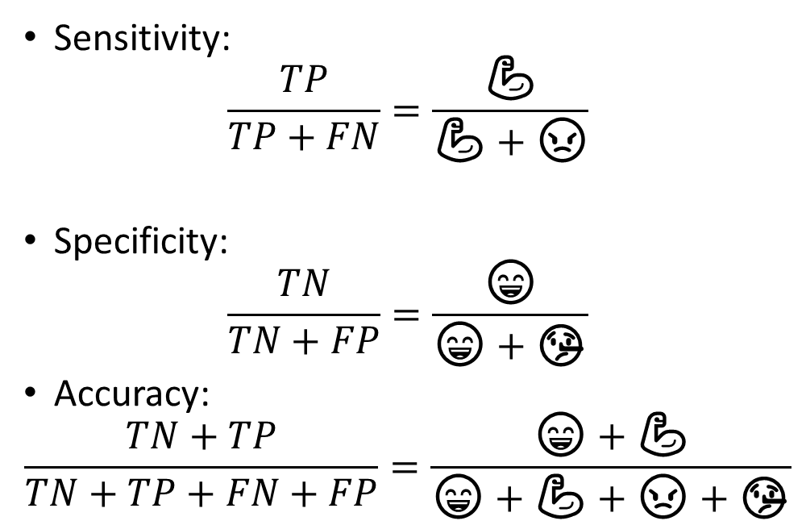
Diagnostics
Sensitivity:
$$\frac{TP}{TP+FN}=\frac{\text{💪}}{\text{💪}+\text{😠}}$$
Specificity:
$$\frac{TN}{TN+FP}=\frac{\text{😄}}{\text{😄}+\text{🤥}}$$
Accuracy:
$$\frac{TN+TP}{TN+TP+FN+FP}=\frac{\text{😄}+\text{💪}}{\text{😄}+\text{💪}+\text{😠}+\text{🤥}}$$
Correctly detecting correlations (power)
Output statistically significant
Specifically-nothing detection
Output statistically insignificant
Correct detections
All (sometimes unknowable) values $∈[0,1]$

